Slide 1
NTE 1010
Introduction to Finance for Engineers
week 7
Stock Markets

Slide 2
NTE 1010 – Introduction to Finance for Engineers
Stock Markets in the World
1- New York Stock Exchange, United States: Founded in 1792, the New York Stock Exchange has been the world’s largest stock exchange since the end of World War I, when it overtook the London Stock Exchange. It has a market capitalization of $22.9 trillion and about 2,400 listed companies.
2- NASDAQ, United States: The NASDAQ Stock Market was founded in 1971 in New York City. NASDAQ had a market capitalization of $10.8 trillion with an average monthly trading volume of $1.26 trillion.
3- Tokyo Stock Exchange, Japan: Founded in 1878, the Tokyo Stock Exchange has close to 2,300 listed companies with a combined market capitalization of $5.67 trillion.
4- Shanghai Stock Exchange, China: It has a market capitalization of $4.02 trillion. It has more than 1,000 listed companies. Though its origins date back to 1866, it was suspended following the Chinese Revolution in 1949. The Shanghai Exchange in its modern avatar was founded in 1990.
5- Hong Kong Stock Exchange, Hong Kong: The Hong Kong Stock Exchange was founded in 1891. It has close to 2,000 listed companies, about half of which are from mainland China. It has a market capitalization of $3.93 trillion.
6- Euronext, Eurozone: Headquartered in Amsterdam, the Netherlands, Euronext is a pan-European stock exchange with a presence in France, Belgium, Ireland, and Portugal. It has approximately 1,300 listed companies with a combined market capitalization of $3.92 trillion.
7- London Stock Exchange, United Kingdom: The London Stock Exchange was founded in 1698. It has more than 3,000 listed companies with a combined market capitalization of $3.76 trillion.
8- Shenzhen Stock Exchange, China: Formally established in 1990, the Shenzhen Stock Exchange has a market capitalization of $2.5 trillion as of November 2018.
9- Toronto Stock Exchange, Canada: Toronto Stock Exchange (TSX) has 2,207 listed companies with a combined market capitalization of $2.1 trillion.
10- Bombay Stock Exchange, India: Founded in 1875, the Bombay Stock Exchange was the first stock exchange in Asia. As of November 2018, it had a market capitalization of $2.05 trillion. BSE has 5,749 listed companies.
Istanbul Stock Exchange as a Market Capitalization of $163.58 Billion.

Slide 3
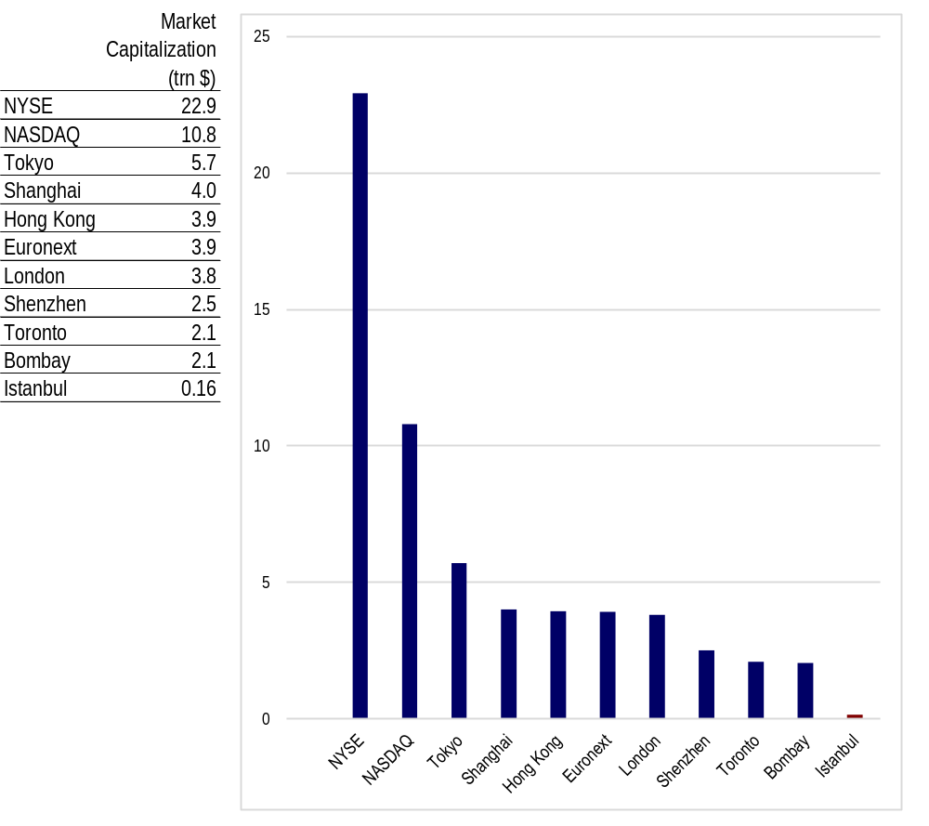
NTE 1010 – Introduction to Finance for Engineers
Stock Markets in the World

Slide 4
NTE 1010 – Introduction to Finance for Engineers
Stock Markets
Computing the Price of Common Stock
Common stock is the principal way that corporations raise equity capital.
Stockholders – those who hold stock in a Corporation –
own an interest in the Corporation proportional to the percentage outstanding shares they own.
This ownership interest gives them the right to vote
and to be the residual claimant of all funds flowing into the firm (known as cash flows),
meaning that the stockholder receives whatever remains
after all other claims against the firm’s assets have been satisfied.
Stockholders may receive dividends from the net earnings of the Corporation.
Dividends are payments made periodically,
usually every quarter in the U.S. and annually in Turkey, to stockholders.
In addition, the stocholder has the right to sell the stock.
One basic principle of finance is that the value of any investment is found by computing
the present value of all cash flows the investment will generate over its life.
The cash flows a stockholder might earn from stock are dividends, the sales price, or both.

Slide 5
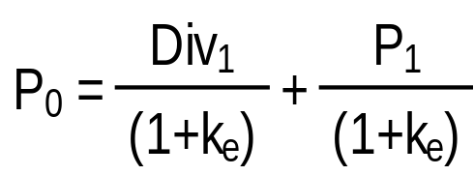
NTE 1010 – Introduction to Finance for Engineers
Stock Markets
The One-Period Valuation Model
To value the stock today,
you need to find the present discounted value of the expected cash flows (future payments).
The cash flows consist of one dividend payment plus a final sales price.
P₀ = the curent price of the stock
(the zero subscript refers to time period zero, or the present)
Div₁ = the dividend paid at the end of year 1
k_{e} = the required return on investments in equity
P₁ = the price at the end of the first year; predicted sales price of the stock

Slide 6
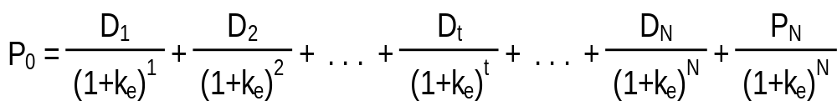
NTE 1010 – Introduction to Finance for Engineers
Stock Markets
The Generalized Dividend Valuation Model
Using the present value concept,
we can extend the one-period dividend valuation model to any number of periods:
The value of a stock today is the present value of all future cash flows.
P₀ = the curent price of the stock
D_{t} = the dividend paid at the end of year t
k_{e} = the required return on investments in equity
P_{N} = the price at the end of year N; predicted sales price of the stock

Slide 7
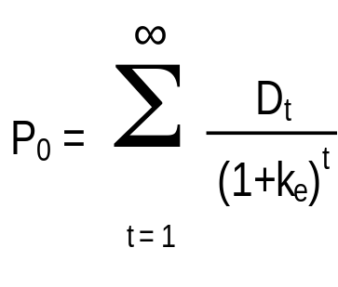
NTE 1010 – Introduction to Finance for Engineers
Stock Markets
The Generalized Dividend Valuation Model
The generalized dividend model may be rewritten without the final sales price.
P₀ = the curent price of the stock
D_{t} = the dividend paid at the end of year t
k_{e} = the required return on investments in equity
This tells us that the price of stock is determined only by the present value of the dividends
and nothing else matters.
In other words, buyers of the stock expect that the firm will pay dividends someday.
Most of the time a firm institutes dividends
as soon as it has completed the rapid growth phase of its life cycle.
However, this model requires that we compute the present value of an infinite stream of dividends,
a process that could be difficult, to say the least.

Slide 8
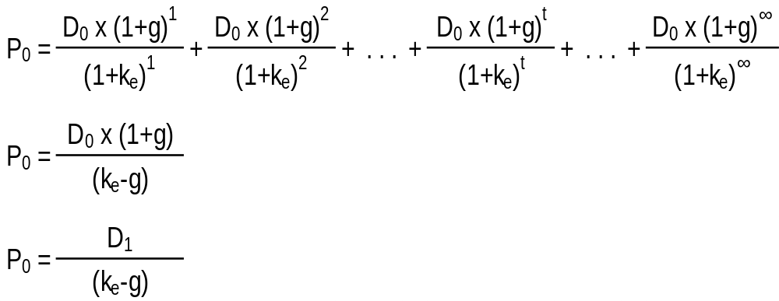
NTE 1010 – Introduction to Finance for Engineers
Stock Markets
Valuation - Gordon Growth Model
The Gordon growth model is a simplified method of computing stock value
that depends on the assumption that the dividends are growing at a constant rate forever.
Given our uncertainty regarding future dividends, this assumption is often the best we can do.
Also, the growth rate is assumed to be less than the required return on equity
which is a reasonable assumption.
D₀ = the most recent paid dividend
g = the expected constant growth rate in dividends
k_{e} = the required return on investments in equity

Slide 9
NTE 1010 – Introduction to Finance for Engineers
Stock Markets
Volatility
The interaction among traders in the market is what actually sets prices on a day-to-day basis.
The trader who values the security the most
(either because of less uncertainty about the cash flows
or because of greater estimated cash flows)
will be willing to pay the most.
As the new information is released,
investors will revise their estimates of the true value of the security and will either buy or sell it,
depending on how the market price compares with their estimated valuation.
Because small changes in estimated growth rates or required return
result in large changes in price,
it is not surprising that the markets are often volatile.

Slide 10
NTE 1010 – Introduction to Finance for Engineers
Stock Markets
Efficient Market Hypothesis
The efficient market hypothesis states that
current security prices will fully reflect all available information,
because in an efficient market, all unexploited profit opportunities are eliminated.
The elimination of unexploited profit opportunities necessary for a financial market to be efficient
does not require that all market participants be well informed.
The efficient market hypothesis indicates that
hot tips and investment advisors’ published recommendations
cannot help an investor outperform the market.
The prescription for investors is to pursue a buy-and-hold strategy
– purchase stocks and hold them for long periods of time.
Empirical evidence generally supports
these implications of the efficient market hypothesis in the stock market.

Slide 11
NTE 1010 – Introduction to Finance for Engineers
Stock Markets
Market Crashes and Bubles
The existence of market crashes and bubles has convince many economists that
the stronger version of market efficiency,
which states that asset prices reflect the true fundemental (intrinsic) value of securities,
is not correct.
It is far less clear that these crashes show that
the efficient market hypothesis is wrong.
Even if the stock market was driven by factors other than fundementals,
these crashes do not clearly demonstrate that
many basic lessons of the efficient market hypothesis are no longer valid,
as long as these crashes could not have been predicted.

Slide 12
NTE 1010 – Introduction to Finance for Engineers
Stock Markets
Behavioral Finance
The new field of behavioral finance applies concepts from other social sciences
such as anthropology, sociology, and psychology
to understand the behavior of security prices.
Loss aversion, overconfidence, and social contagion can explain why
trading volume is so high, stock prices become overvalued, and speculative bubbles occur.

